Slide 1

Predicting NFL Draft Position from Historical Data
By Kevin Angotti

Slide 2
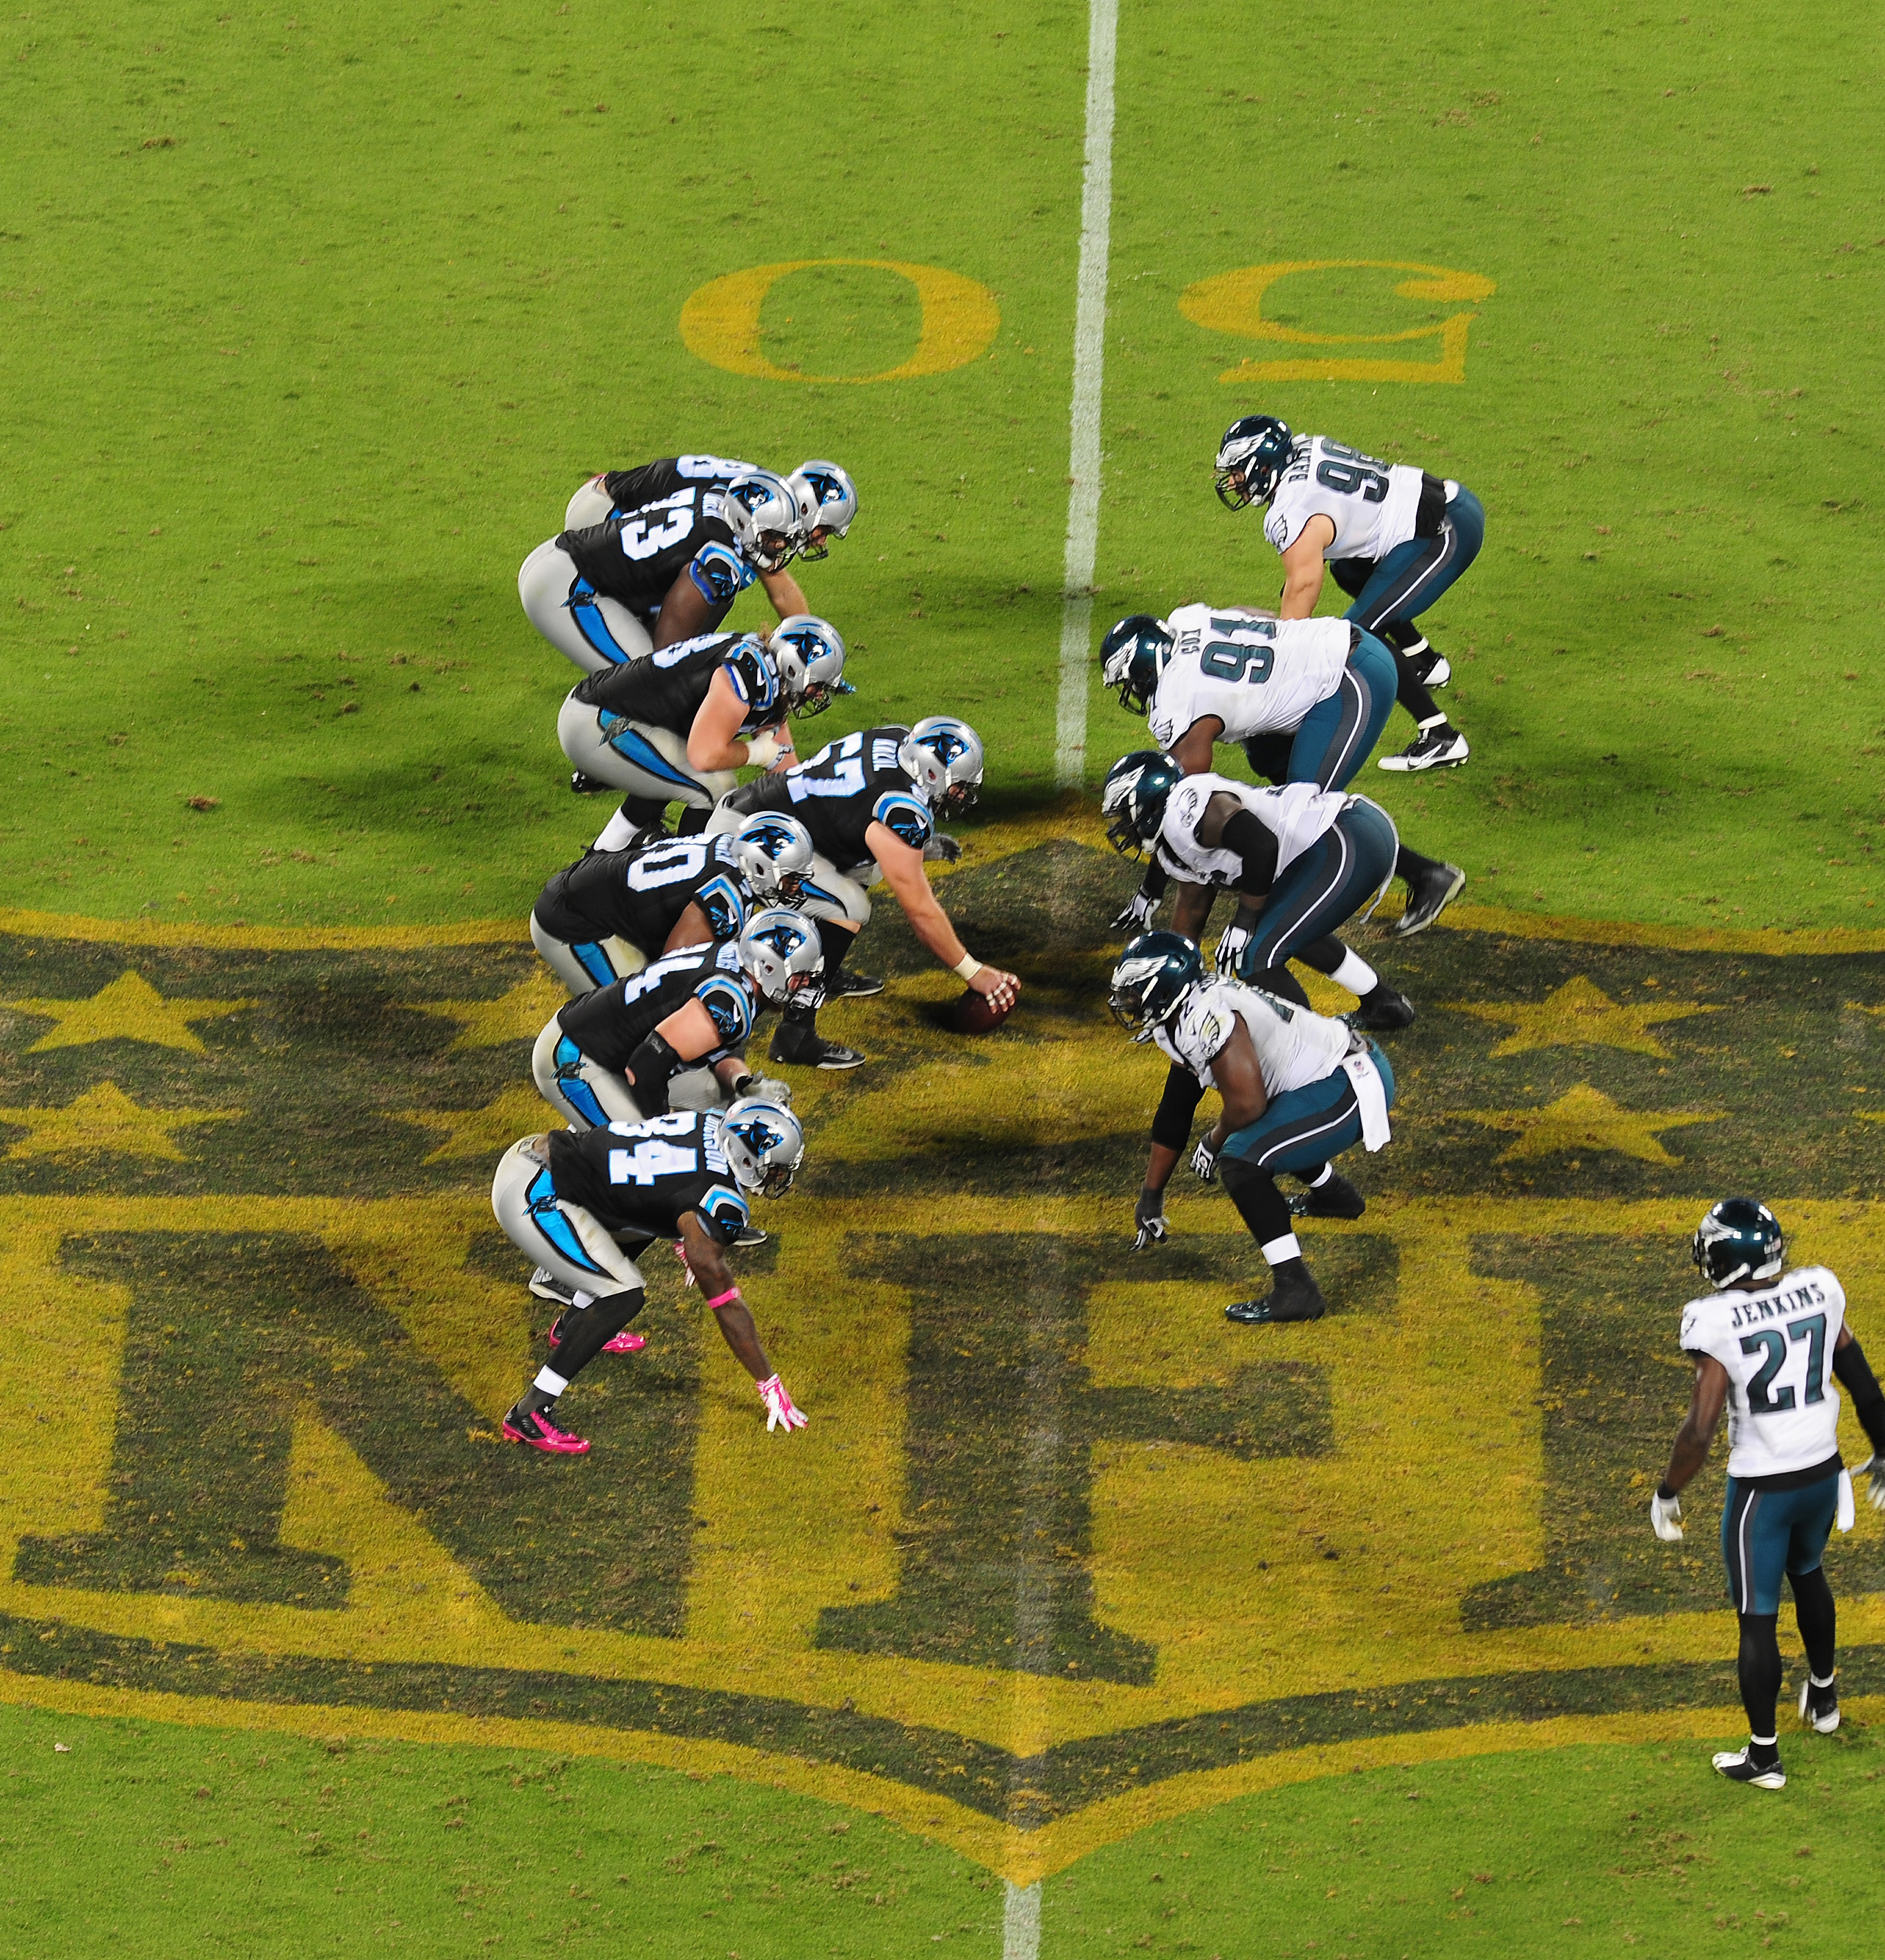
Introduction:
The NFL is one of the largest professional sports in the world.
According to most sport rankings like Stat Score which uses the Gallup Poll for its rankings; places American Football (NFL) as the most popular in the United States.
Both in polling and Television Ratings the National Football Leagues (NFL) has been at that the top of the sports spectrum for quite some time.
According to a Gallup Poll, the NFL surpassed the MLB in the mid 1970’s as Americas most popular sport. Even though Baseball is still thought of as Americas greatest pastime.
The most direct way into the NFL is through the NFL Draft, and the path to the draft usually starts with the NFL combine. This Project looks to dive more into aspects of this process.

Slide 3
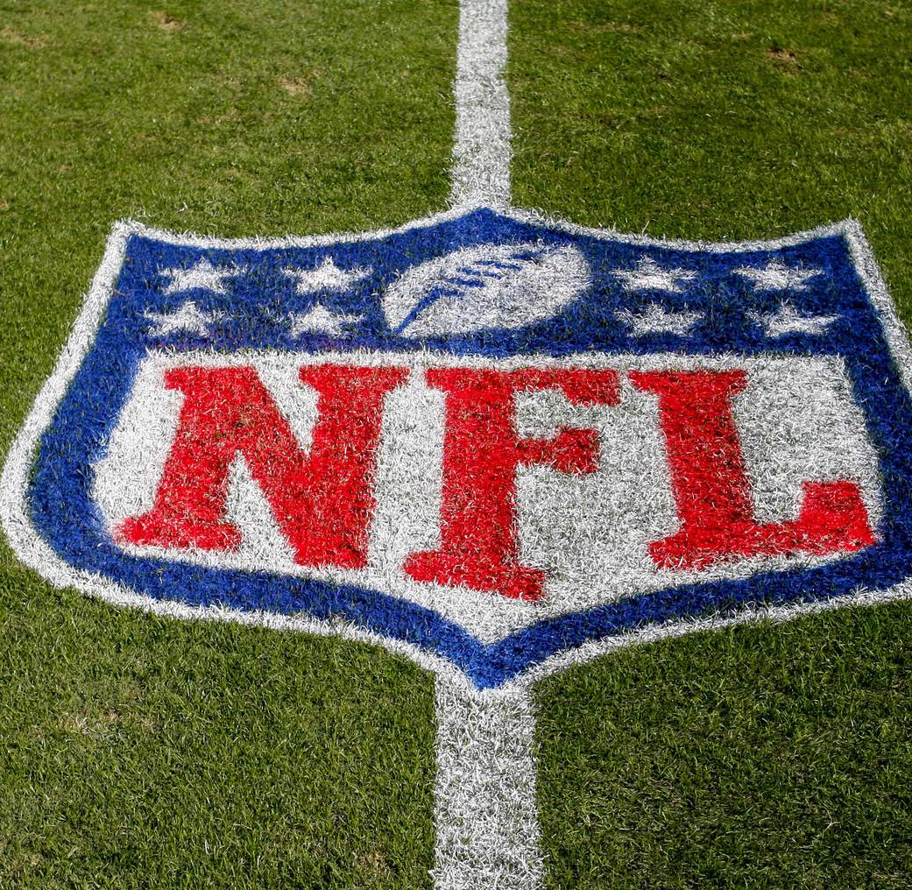
Research Questions:
Can a player's AV (actual value) be changed by using predictive analytics?
Which variables contribute most to a prediction change?
Which Position of AV (actual value) changes the most?

Slide 4
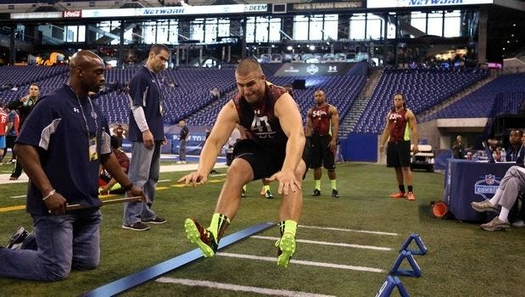
Methods:
For this project, I used a combination of R, Python, and Power BI to complete various data analysis approaches.
I first started with simple linear regression in the R programming language to get a sense of what each of the variables within the dataset might have to tell me.
From there I used the Python programming language to conduct the main modeling for the project.
Power BI was used to create a series of visuals for the project to include a snapshot of what a typical NFL combine player might look like.
Additional methods included Exploratory Data Analysis (EDA), OLS Linear regression, a random forest and a decision tree. All were used to formulate the concluding results for this project.

Slide 5
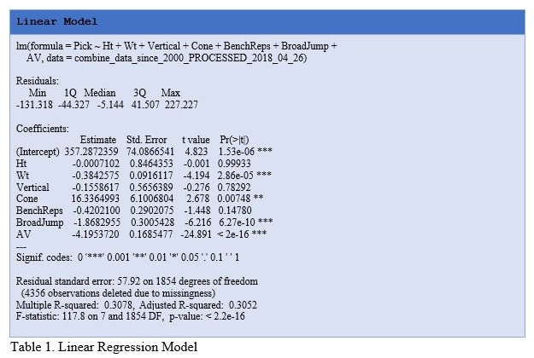
EDA:
Within R there is a simple linear regression tool that can be used to quickly get a return of your dataset to determine any significance variables might have with one another.
Choosing just the metrics that a player will be measured against at the NFL scouting combine the LR model returned weight, cone, broad jump and AV as variables to keep an eye on.
The model returned an R-Squared measure of .31 and an F-Statistic of 117.8
From the R’s results I created initial visuals with Power BI to get a better look at how these variables look.

Slide 6
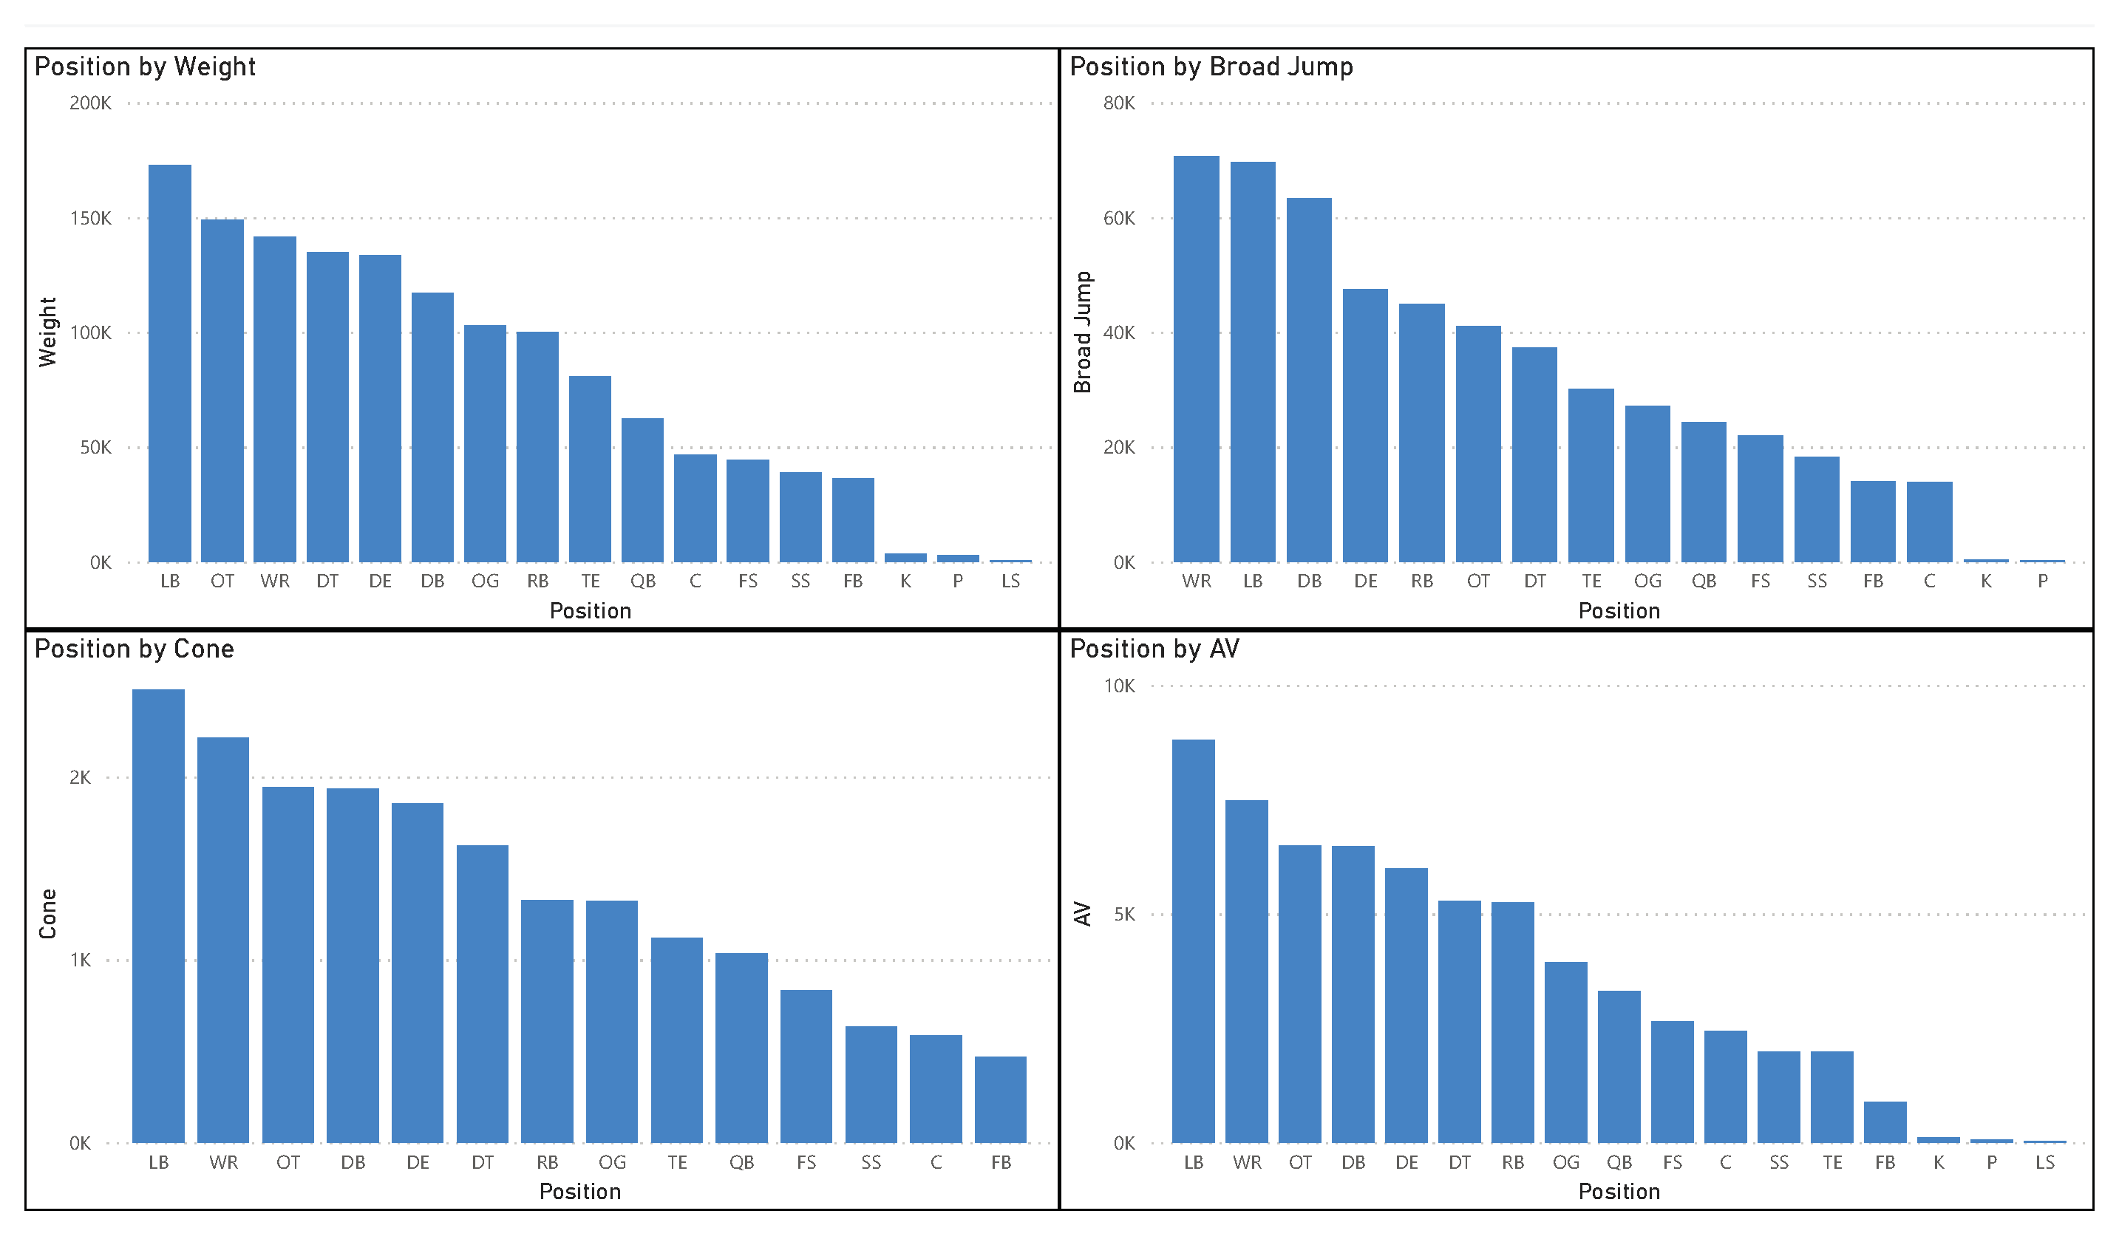
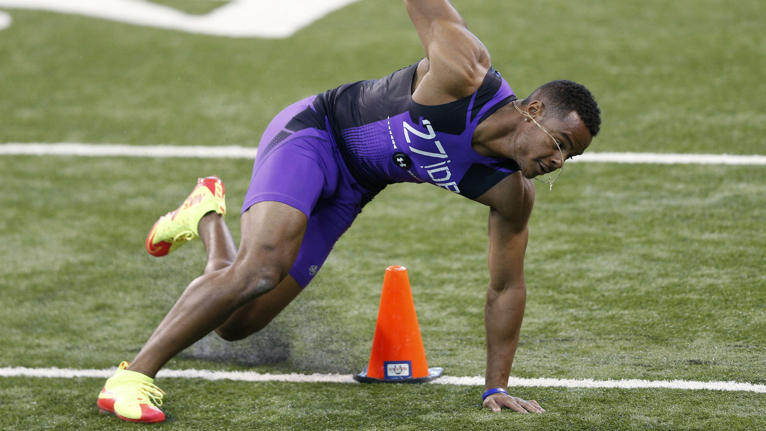
EDA Continued:
Notes:
Highlighted the linear model from R; the 4 areas the combine measures which have had most significance are shown above.
Talk over visuals

Slide 7
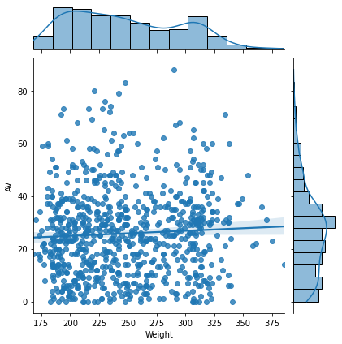
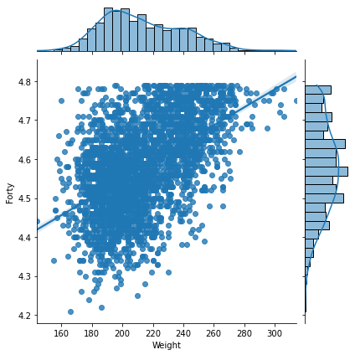
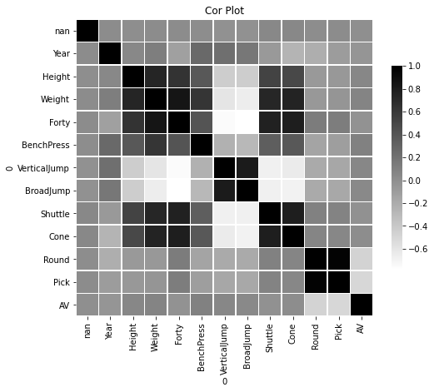
EDA Continued:
Notes:
The Coloration matrix shown center – returns some important clusters to point out;
shuttle, cone and 40 ----and --- height, weight, and bench
AV & Weight left – ideal above 20 with a weight of 200-225
40 & Weight right – ideally times in the 4.4’s to 4.6’s with a weight of 190-225

Slide 8
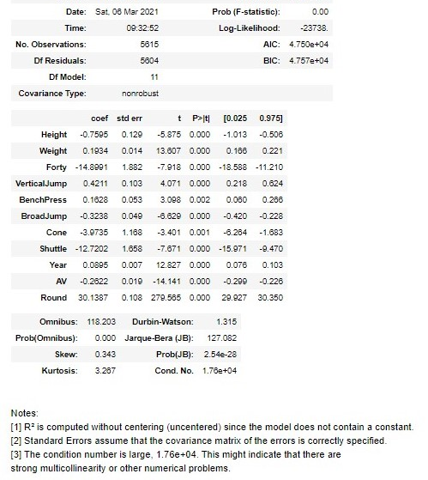
Modeling:
In Python I started with an Ordinary Least Squares models or OLS.
The model takes the variable I wished to predict on in this case (Pick) and run it against the variables identified during EDA. This includes the variables noted from R’s initial LR model.
The first OLS model was used to narrow down the exact variables to run with the second OLS model which in-turn will be used to make predictions for Draft Pick selection from a historical evaluation.
From the results on the left Height, 40, Cone and Shuttle were the most significant.
The score of this model returned an R-squared of .98 & a condition score of 1.76e+04.

Slide 9
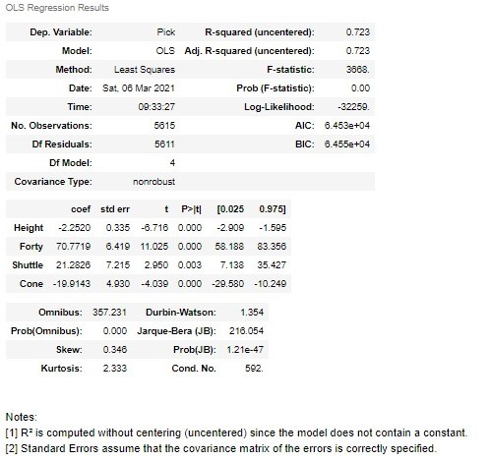
Modeling Continued:
The second OLS model using the 4 most significant variables from the first model as seen from the figure to the left.
The R-Squared dropped to .72 however, the condition score of the model improved to 592.
Providing a good set of variables to use for the Pick prediction formula.

Slide 10
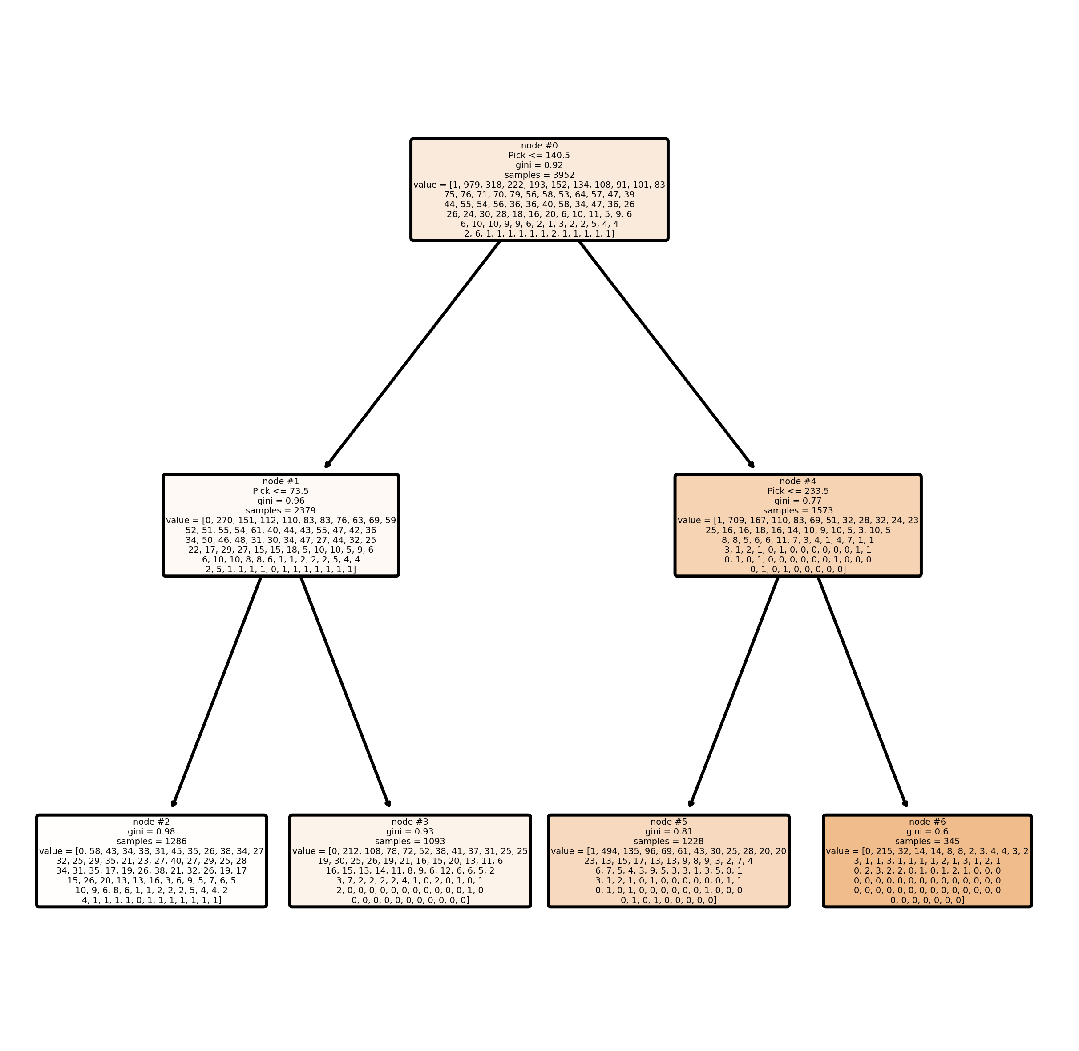
Modeling Continued:
Before moving into prediction of draft pick positioning and its change, I want to add in the other two models. I ran. A random forest and decision tree were added in to go along with the OLS prediction model.
The random forest shows that the dataset in general was significant by returning an accuracy of .71%.
This helped me determine if a decision tree could provide the project more information.
The decision tree takes the variable Pick as the root node and helps narrow down the number of samples from the dataset that meet the required target information.
Looking for players lower than Pick 140 and above 73 the tree would filter down to the bottom, or the second leaf from the left with its 1,093 samples out of the 6000 players measured and provides a Gini of .93. This could help teams narrow down value in a range of predicted Picks to analyze further.

Slide 11
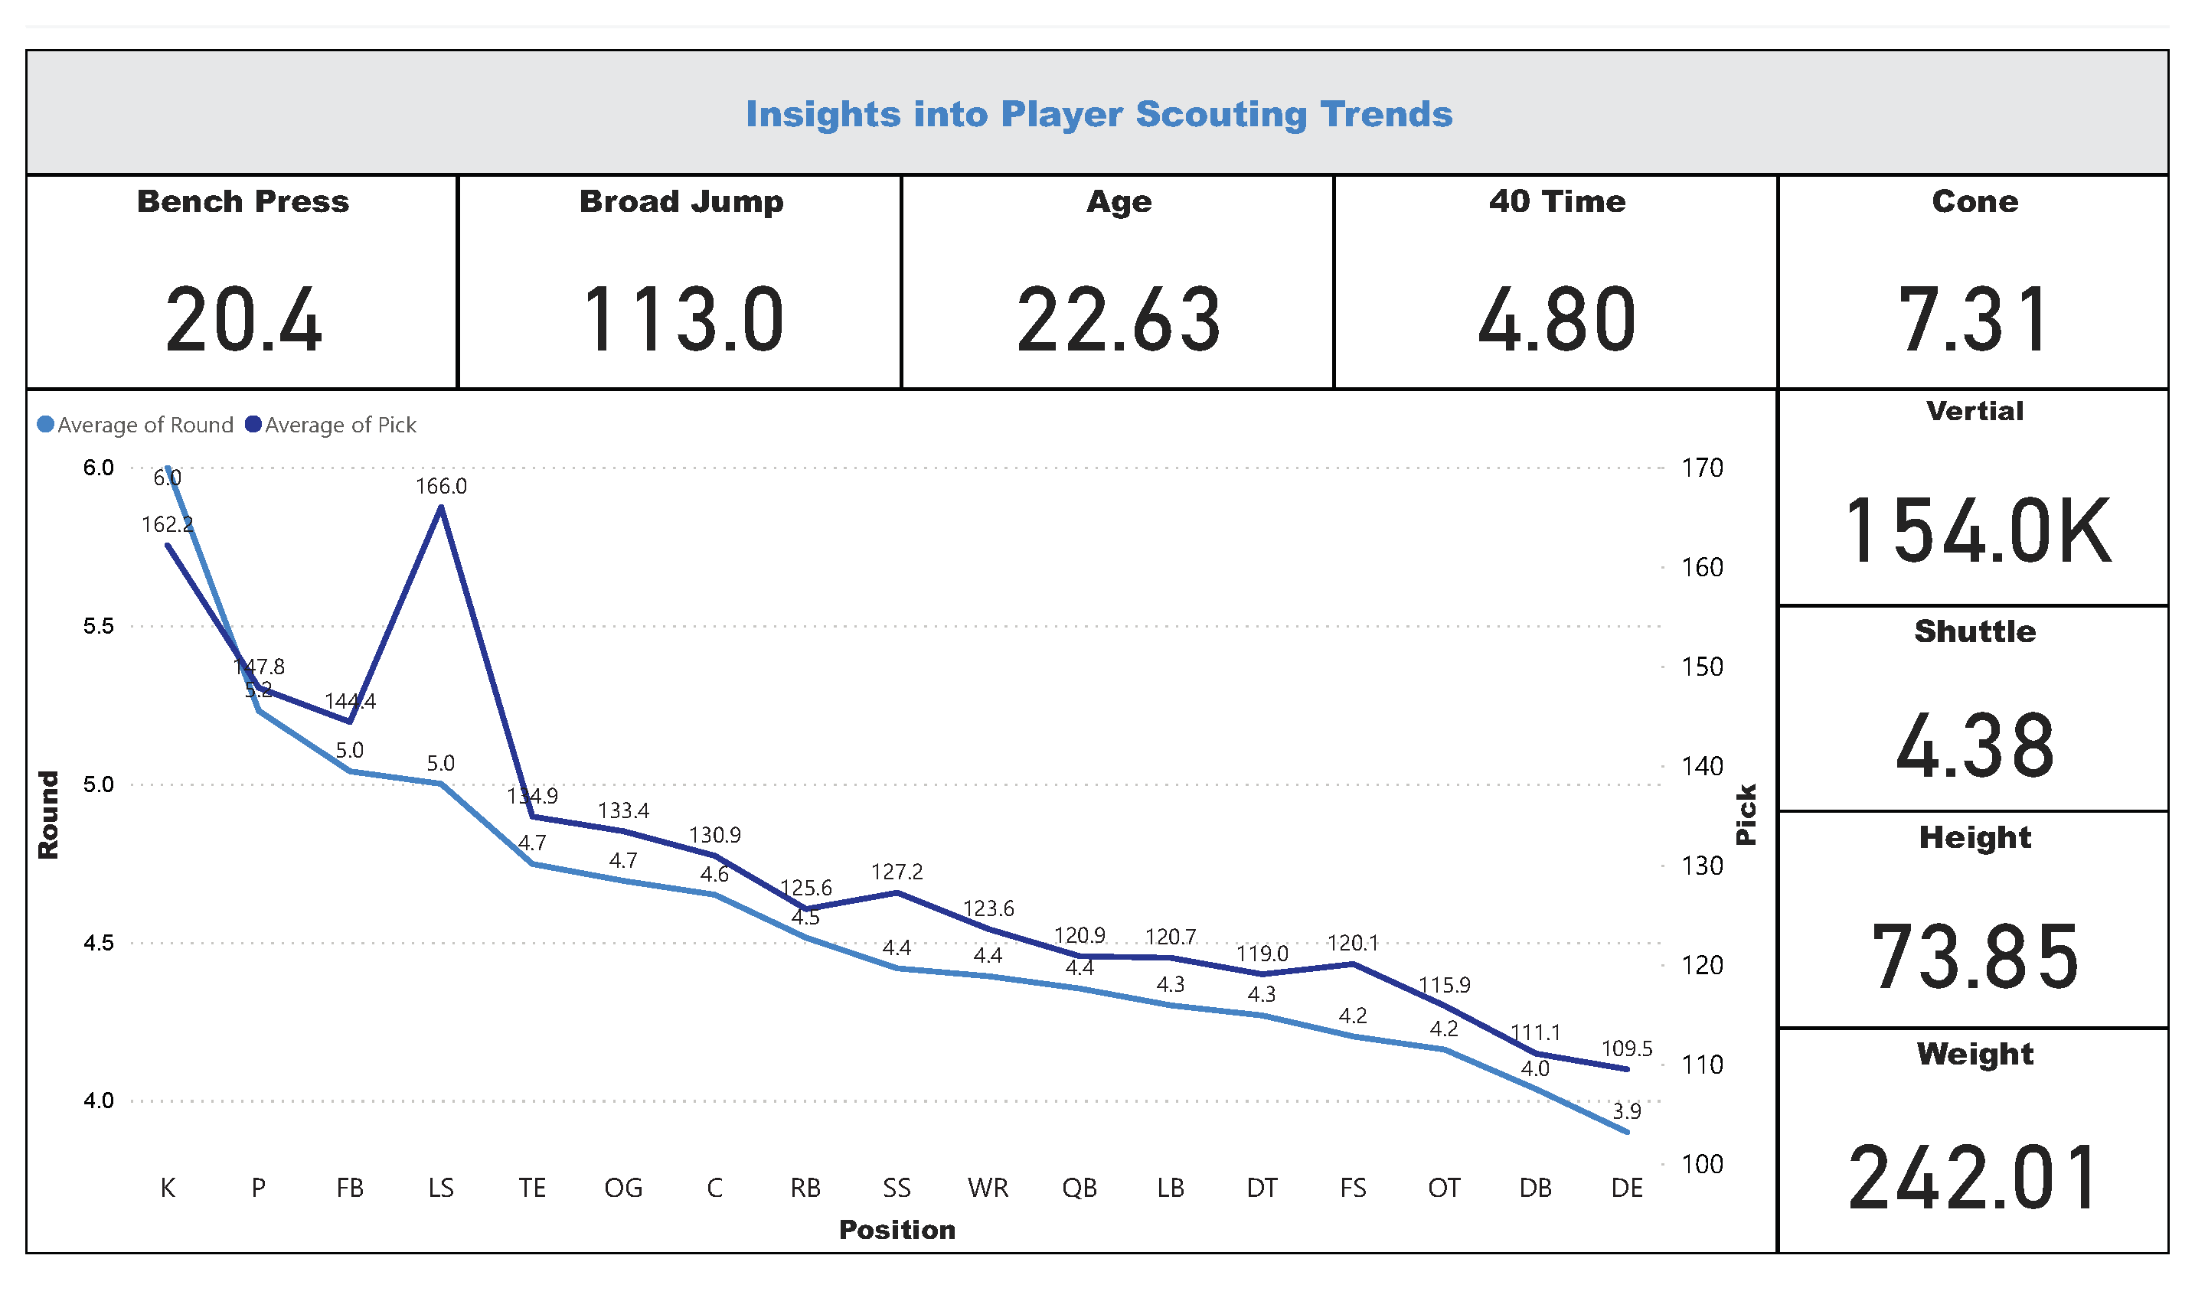
Discussion:
Notes:
Here you can see what a typical NFL player attending the NFL combine might look like based on 28-year averages (1987-2015). If a player meets these measurements, they are most likely be drafted by round 4.

Slide 12
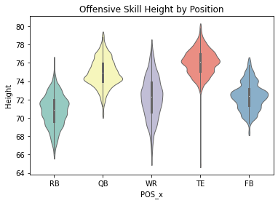
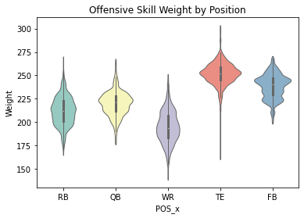
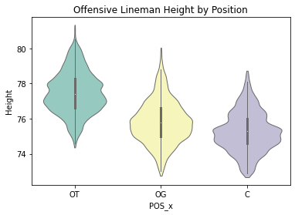
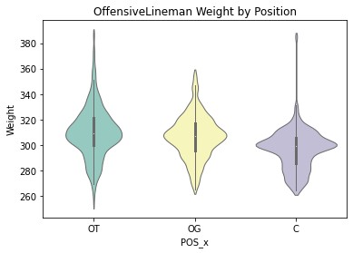
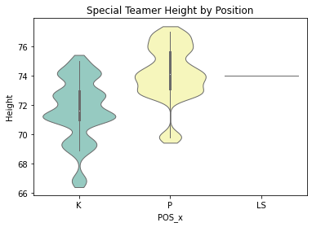
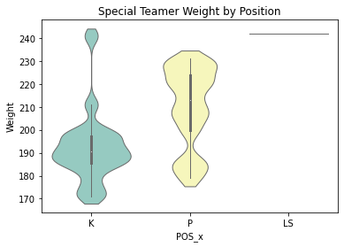
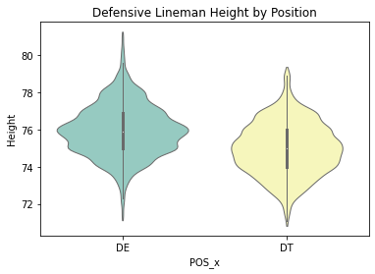
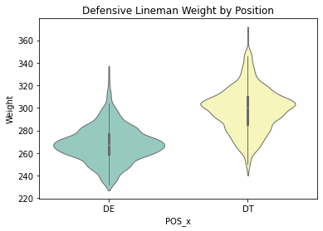
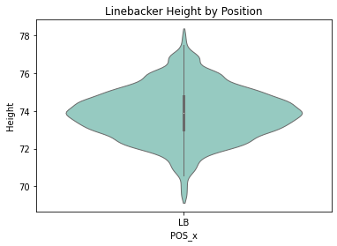
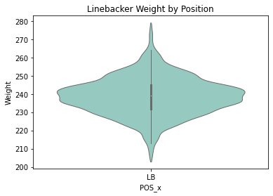
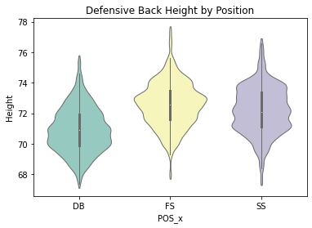
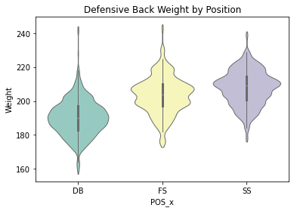
Discussion Continued :
Notes:
As seen in the previous slide each of the position group shown meets the average measurements for height and weight. Some takeaways here is that Defensive line, offensive line, and linebacker groups tend to be higher for the height ad weight categories. While the Skill positions fall in line with height, but the weight is significantly lower.

Slide 13
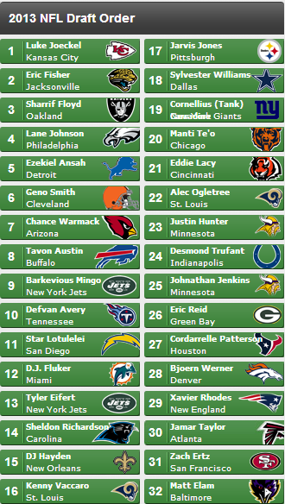
Discussion Continued:
Most statistics regarding a mock draft or prediction to where a player will be drafted revolve around college statistics and the combine results.
The model I created takes this information and compares it to players from previous drafts to get a more detailed prediction.
To the left you have one of the 2013 mock draft results for the first round.
Cordarrelle Patterson was projected to go round 1 pick 27 to Houston, though he has had a talented career as a returner; he has not been the receiver that most would have expected. He was drafted round 1 pick 29, had teams used the model created for this project Patterson would have been projected as the 96th pick which would have put him somewhere in the id 3rd round.
Anther notable player Tom Brady, arguably one of the winningest quarterbacks of all time was drafted round 6 pick 199. this model would have put him in round 5 pick 162.

Slide 14
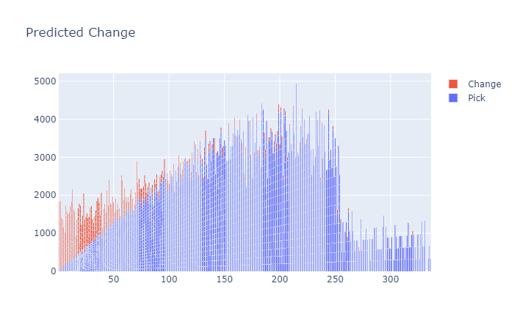
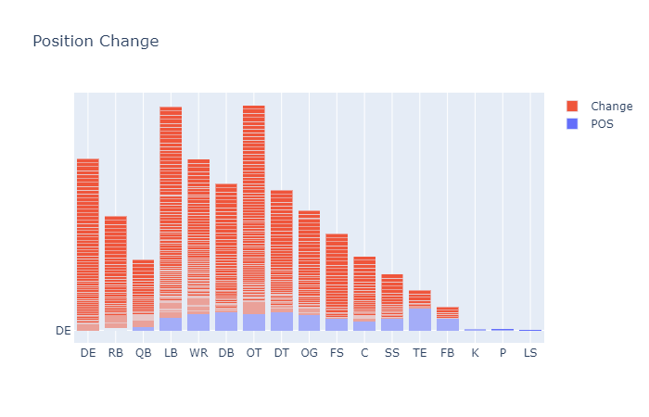
Discussion Continued:
Notes:
The results of the model provided a good amount of change based on draft locations. From the two figures shown rather the change be positive or negative just about every player measured during the measured returned some change in prediction. The position most affected looks to be either offensive tackle or a linebacker.

Slide 15
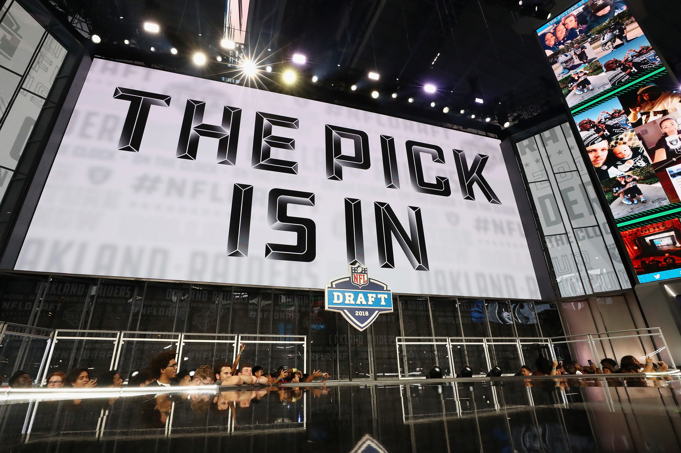
Conclusion:
All three of the project goals were achieved. A players AV or the pick location was successfully predicted, Height, Weight, Shuttle, and Cone were the most notable measurements that could be used for prediction; and the positions that had the highest change from modeling were LB and OT.
Looking ahead I plan to integrate these predictions into a tool that teams could use for future draft analysis.
Outside of profession teams, individual players may find the tool useful for measurement, this could help focus where improvement is needed to raise their draft positioning.
Notes:
?

